Slide 1

Butler Bootcamp Data Analytics Final Project
Theodore Ofner, Kyle Brumbaugh, Andrew Philbeck, and Seth Bogue

Slide 2
Project Planning - Assignment of Roles
Andrew - Data Cleaner extraordinaire
Kyle - Project Planning and Database management
Theodore - Machine Learning Expert
Seth - Dashboard Guru

Slide 3
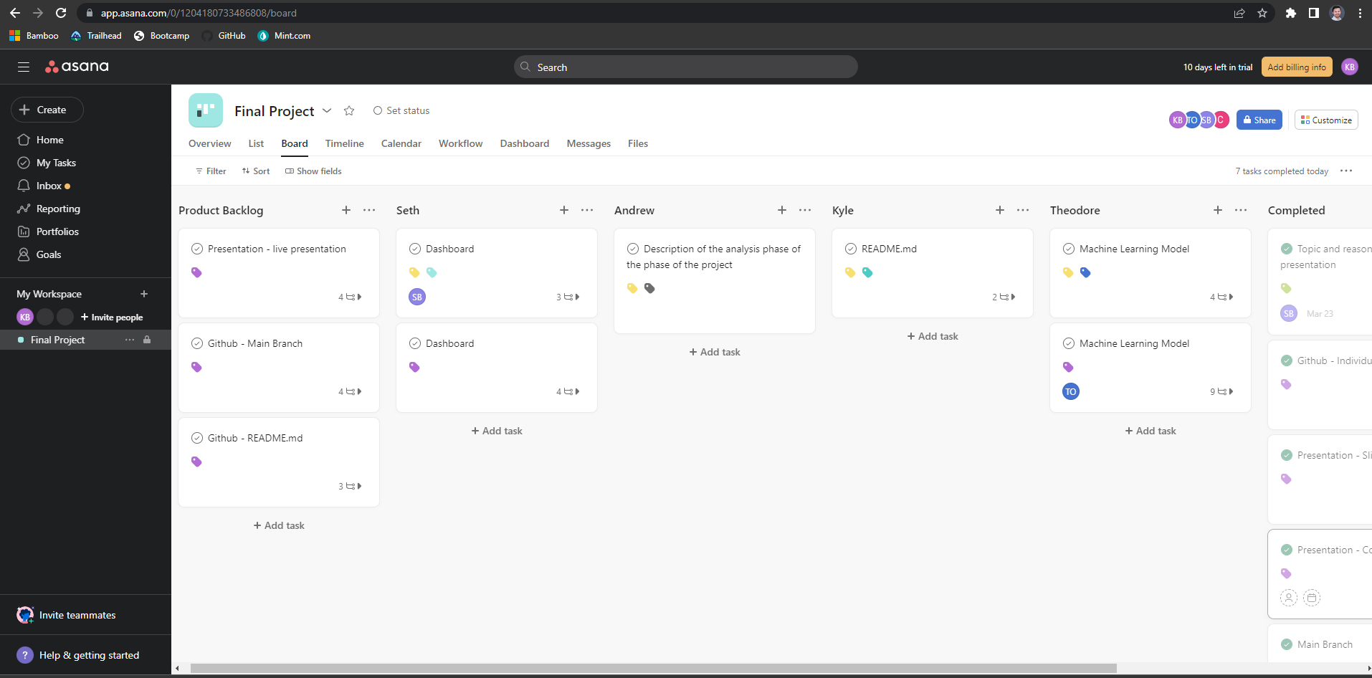
Asana for Project Management

Slide 4
Selected Topic
Our project will focus on analyzing data from the International Movie Database (IMDb) and attempt to apply machine learning to predict movie ratings
IMDb is an online database where members can rate movies, tv shows, podcasts, home videos, video games, and online streaming content.
Why?
Large, free, relatively clean dataset
The database is massive, containing more than 10 million titles and the website has more than 83 million registered users.

Slide 5
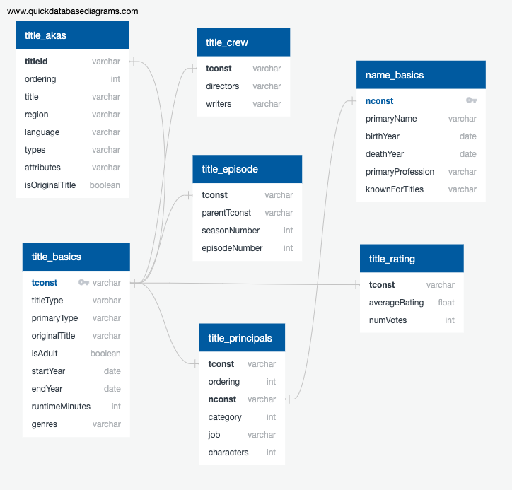
Description of the Data
IMDb data is available to the general public and can be accessed at: https://datasets.imdbws.com.
IMDb had some decent documentation on what the datasets held as well: https://www.imdb.com/interfaces/
Data is structured as a network of tables keyed with a unique identifying code for each film.
We are interested in genre, rating, votes, release year, and region of production.

Slide 6
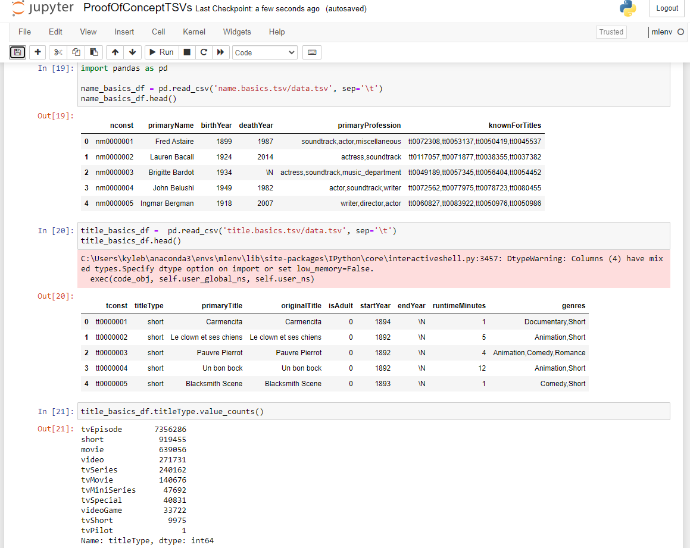
Proof of Concept of Data
What’s a .tsv.gz
Can we use .tsvs?
sep=’\t’ allowed us to use pandas.read_csv
This is a LOT of data

Slide 7
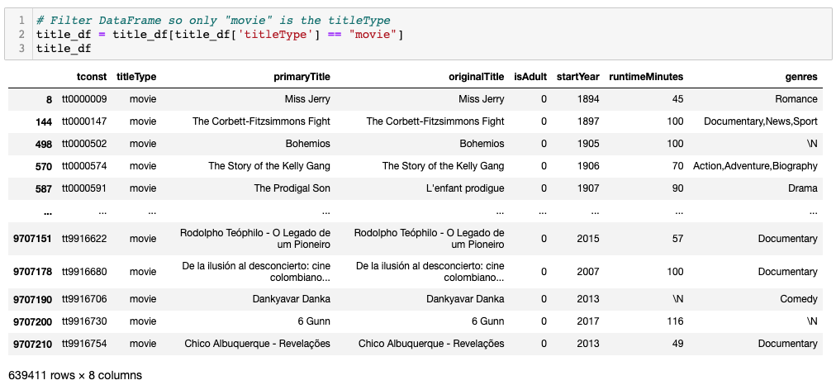
Cleaning The Data
The IMDB Data is extensive and covers everything from short films to television shows.
We were only interested in “Movies” so we filtered out everything that did not fit that description in the “titleType”

Slide 8
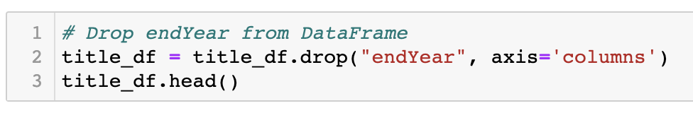
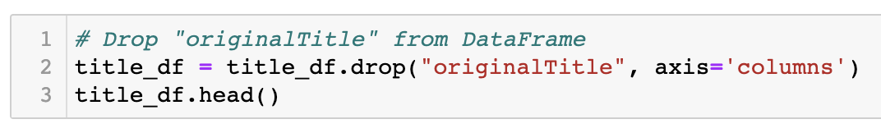
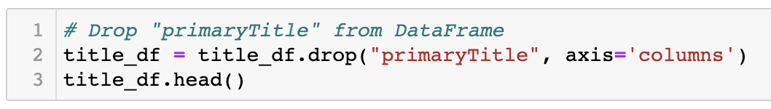
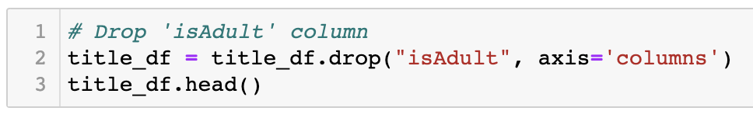
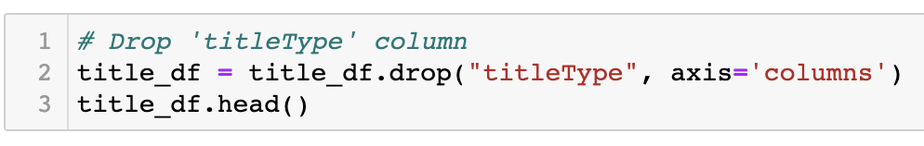
Cleaning The Data
A number of columns were unnecessary.
Dropped endYear
Dropped “originalTitle”
Dropped “primaryTitle”
Dropped “isAdult”
Dropped “titleType”

Slide 9
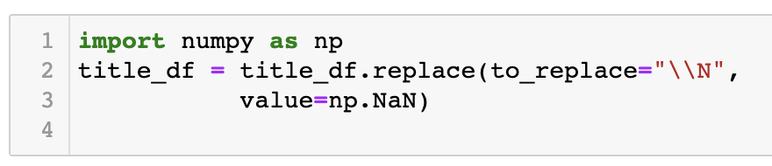
Cleaning The Data
To drop the NaN values we used an escape character to replace “\N” with NaN.

Slide 10
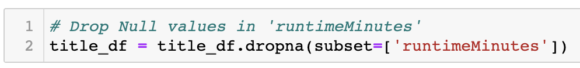
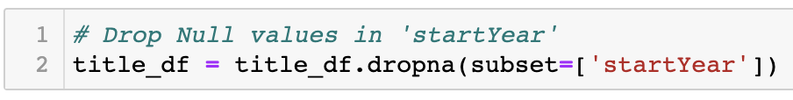
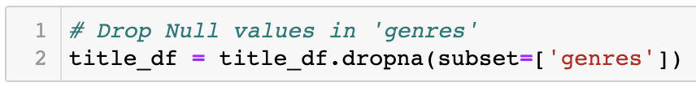
Cleaning The Data
Dropped the null rows with “NaN” value.

Slide 11
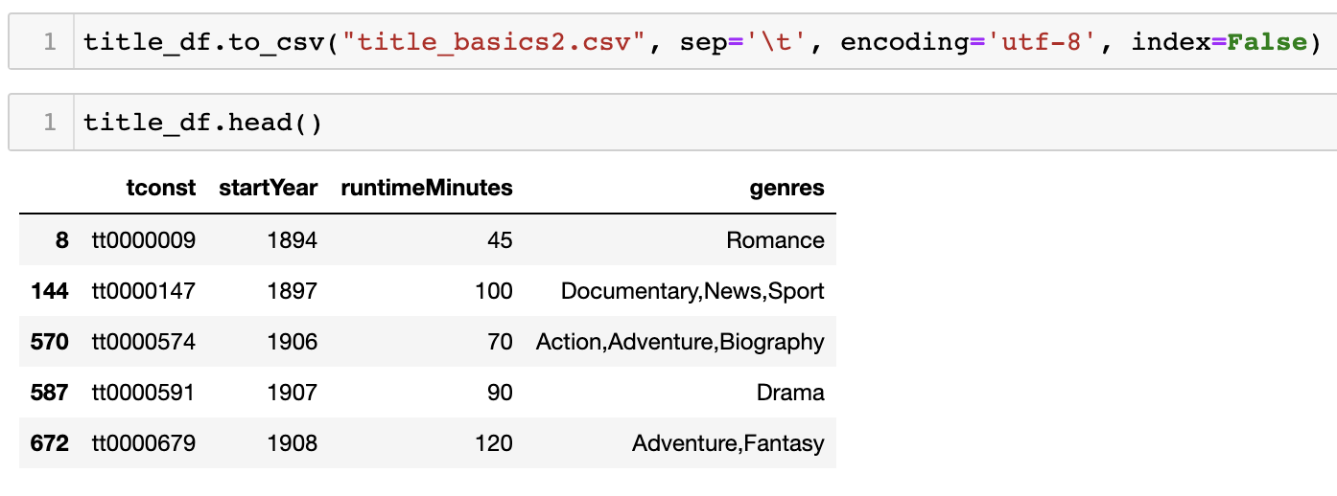
Cleaning The Data
Once the title.basics.tsv was cleaned it was exported as title_basics2.csv

Slide 12
Cleaning The Data
Created similar .csv files based on other datasets
actor_df.csv
actress_df.csv
director_df.csv
name_df.csv
principals_df.csv

Slide 13
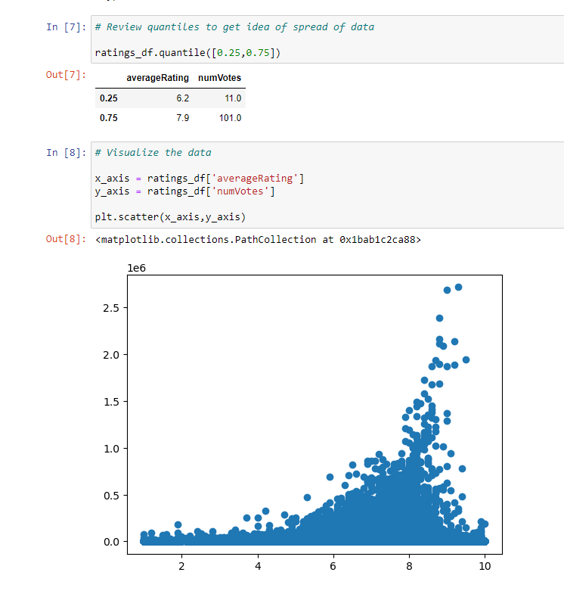
Movie Ratings
Most interested in ratings
Majority of movies had less than 101 votes
We address this later in the machine learning model
Scatter plot on a log scale
Some movies had a LOT of votes and high ratings
Majority of movies had few votes and seemingly random ratings

Slide 14
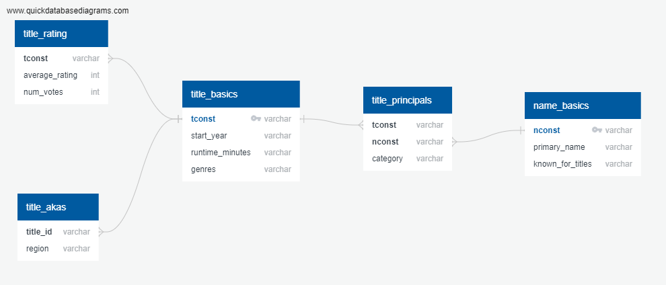
Final Database Diagram

Slide 15
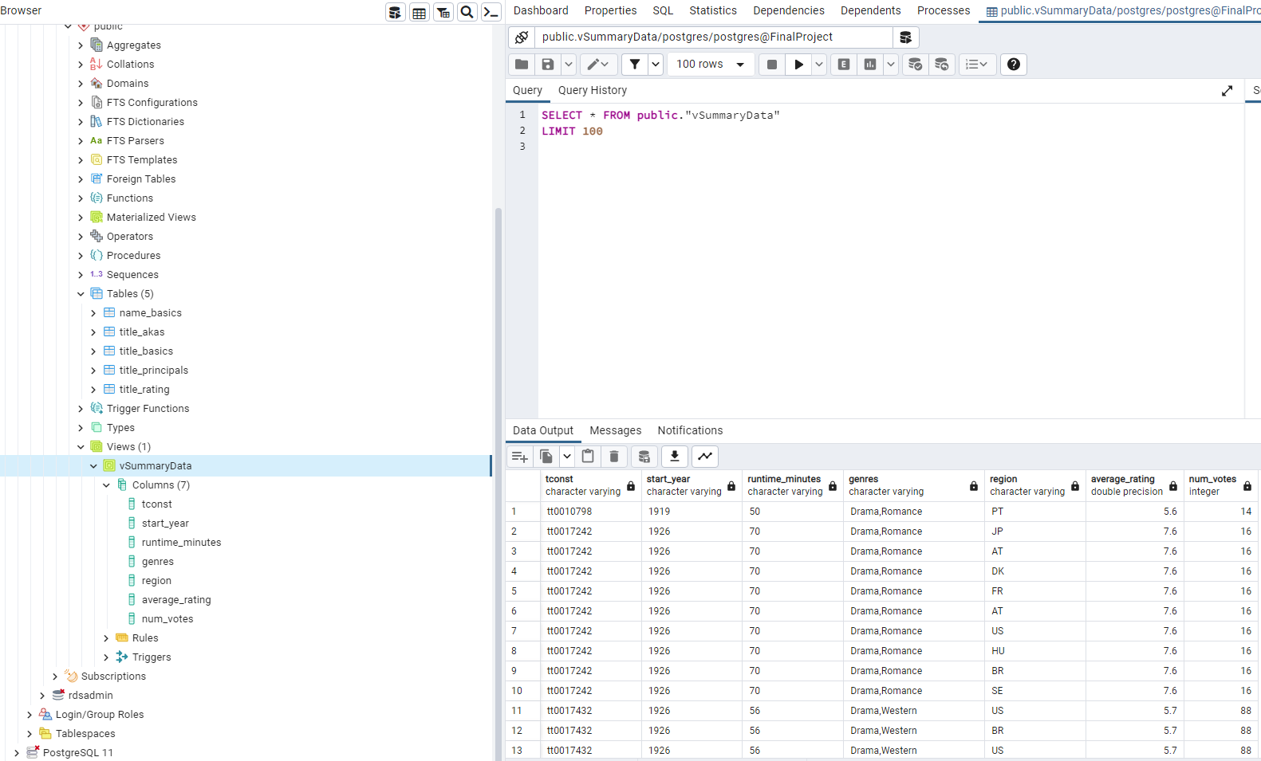
Database
Amazon RDS
Imported the data into pgAdmin instance hooked to RDS using .csvs
Queried using psycopg from Google Colab
Individual datasets were joined using psycopg and were used to train our machine learning model

Slide 16
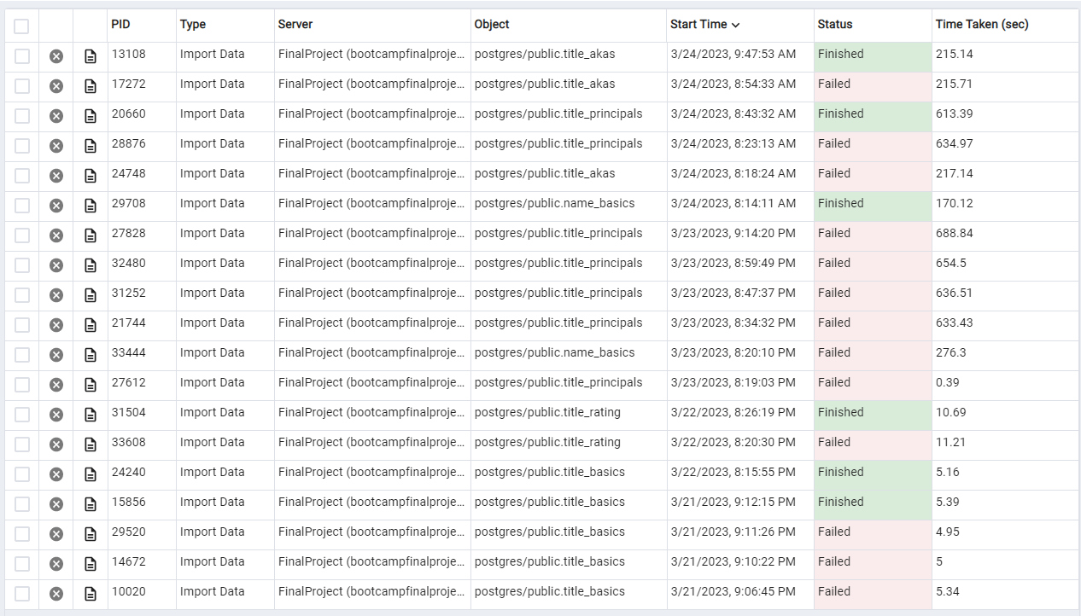
Database Struggles and Lessons
Foreign key restraints
Datatypes are important
Patience is a virtue
It might be better to walk away

Slide 17
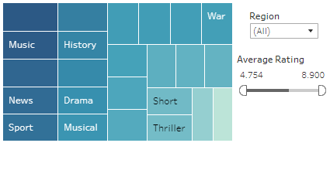
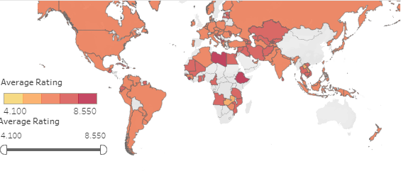
Questions for Analysis
Are there significant differences in ratings between genres?
Are there significant differences in ratings between regions?

Slide 18
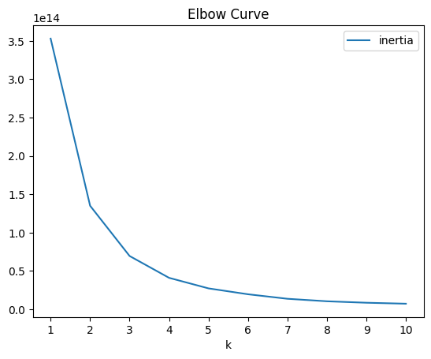
Questions for Analysis
Does runtime effect ratings?
We will see in our K-means analysis that, broadly speaking, a longer film receives lower and fewer ratings overall.
Can k-means clustering identify any meaningful clustering in the data?
Looking at an inertia curve we see potential elbow movies as values:

Slide 19
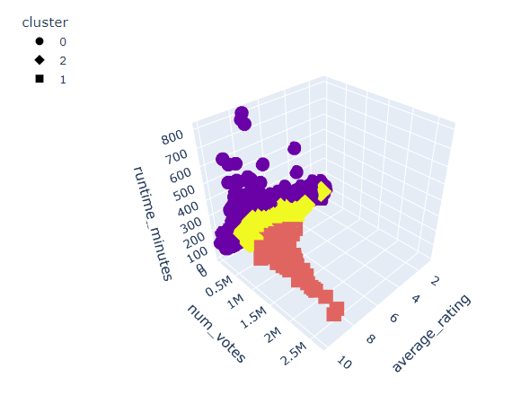
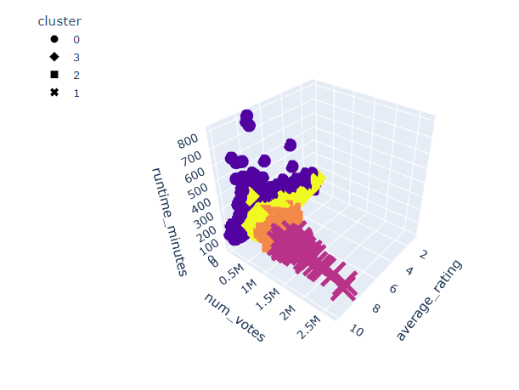
K-means visualizations
K-means clustering models with 3 and 4 models

Slide 20
Description of the Analysis
The lowest cluster is by far the largest cluster comprising over 90% of the data (97% for 3 clusters and 95% for 4). In other words, it is incredibly difficult to make a highly rated, highly viewed film.
Our k-means model found 3 large clusters of data with increasing average rating, numbers of votes and decreasing runtime, which suggest loose relationships between these three factors.
We attempted a number of predictive neural network and logarithmic models trying to predict clusters based on genre and region information, but all of them overwhelmingly failed to predict the higher clusters.
We conclude: though trends exist within the data, there is not even a loose formula which guarantees success based on general information.

Slide 21
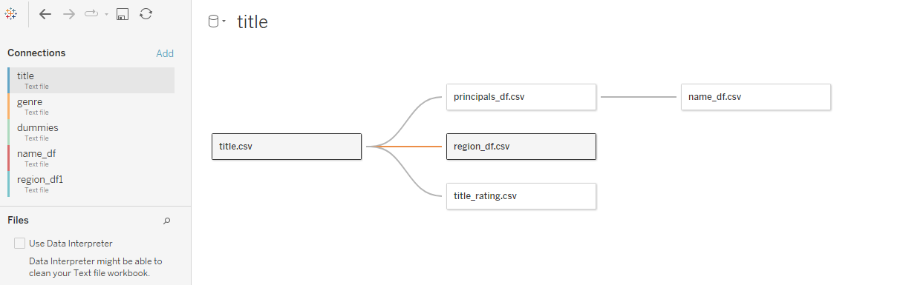
Dashboard and Visualizations
Five tables were linked together in Tableau to create visualizations
title.csv
principals_df.csv
Name_df.csv
region_df.csv
Title_rating.csv
Tables were related based on “tconst” variable
Unique identifier for each movie

Slide 22
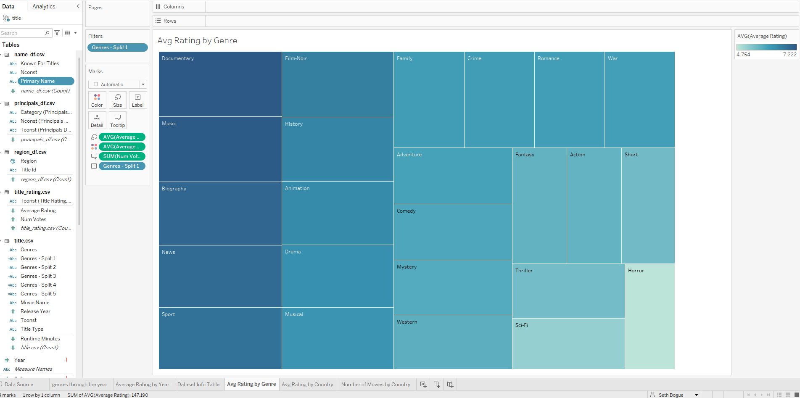
Dashboard and Visualizations

Slide 23
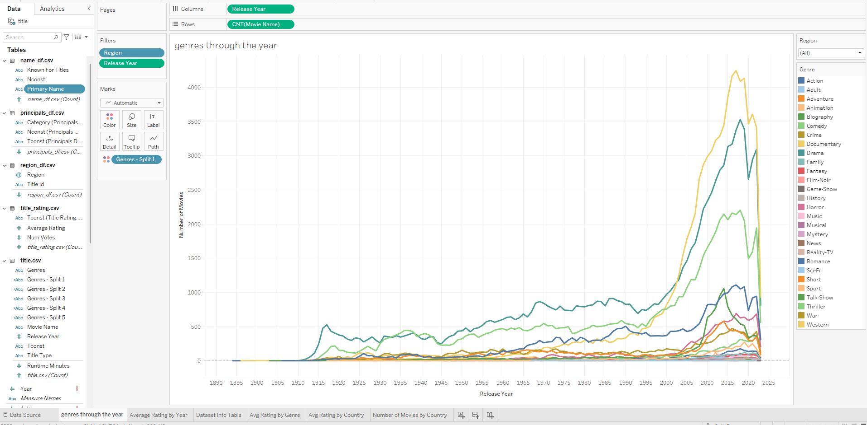
Dashboard and Visualizations

Slide 24
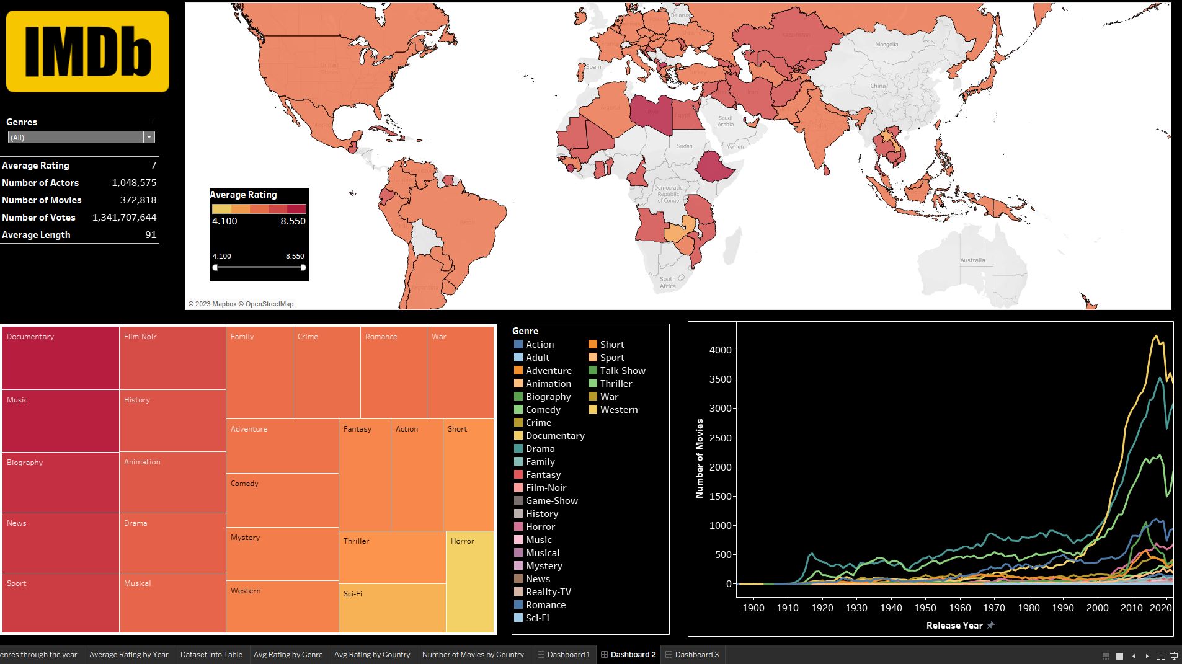
Dashboard and Visualizations
https://public.tableau.com/views/Final_Project_IMDB_Dashboard/Dashboard3?:language=en-US&:display_count=n&:origin=viz_share_link

Slide 25
Future Research/Limitations
Couldn’t apply principals (actors, actresses, directors) to ML model due to needing to pivot out all the principals
For predictive models, we suggest directly incorporating content such as tokenized scripts, or applying sparse data methods to actor and director data.
Digging into the actor and director data as filters on the dataset using big data techniques to handle the dimensionality.

